Slide 1
Kakamega
Zero-Waste
Seven WTEG Power Plants – 3,500 tpd MSW
Circular Economy
Alset Power Company, Inc.

Slide 2
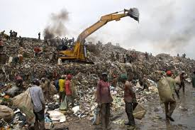
Kakamega Zero-Waste Seven WTEG Power Plants – Circular Economy
The Government of Kakamega County would provide to Alset Power Company 3,500 tons per day, 365 days per year of MSW to be processed with our new Zero-Waste WTEG power plants of which there would be seven (7) WTEG power plants. Siemens or a Siemens subsidiary will engineer, provide procurement and construct all two WTE gasification power plants in Kakamega. The seven WTEG power plants will be operated and maintained by Siemens O&M and local professionals will be hired for the jobs. Project funding provided USD $525 million.

Slide 3
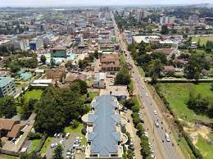
Kakamega Zero-Waste Seven WTEG Power Plants – Circular Economy
Each of the seven Zero-Waste WTE gasification power plants will be built in strategic locations around Kakamega so as to reduce transportation costs, gas emissions and wear and tear on the streets and roads. Former projects introduced to Kakamega government MAY HAVE ONLY allowed for one large incinerator which would not provide these same benefits.
3

Slide 4
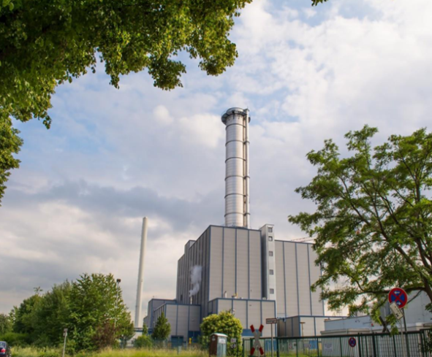
Kakamega Zero-Waste Seven WTEG Power Plants – Circular Economy
Previous proposals to Kakamega may have looked at incineration of waste which always provides a ten percent or more residue after the incineration process. This residue is highly toxic to the environment and as such would never comply with the Kenya Clean Air Act. The toxic air emissions spew pollutants into the atmosphere which include dioxins and furans which are harmful to breathe. The dioxins and furans are also discharged within the fly-ash. Alset Power Company provides a Zero-Waste gasification technology that is the first of its kind that does not allow harmful dioxins into the atmosphere or the ash. The ash that remains after the process is 100% inert and contains no harmful dioxins.
Gasification – not polluting
Incineration – very polluting
4

Slide 5
Kakamega Zero-Waste Seven WTEG Power Plants – Circular Economy
Alset Power Company will provide to each of the seven WTEG power plants state-of the-art monitoring software that will monitor in real-time all WTEG power plant emissions. We are happy to set up monitors in your DENR office so that the Department of the Environment can effectively see first-hand the levels of various particles and gases that are emitted into the air from each of the five stacks. No other company has proposed to share this information directly with the government in this manner. The reason that we do this is because we have nothing to hide, and we are very proud of the technology that we have presented for development in Kakamega.
ZERO Waste – ZERO Landfill – Circular Economy
100% Recycling of glass, metals, ash, ceramics, plastic is used for energy production, carbon dioxide is used in food production.

Slide 6
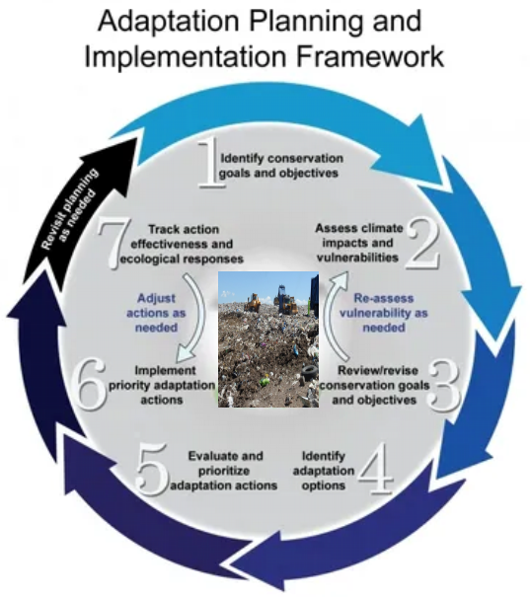
Waste-Circular Economy
Kakamega Sustainable Waste Circular Economy
A complete Sustainable Waste management strategy adapting Kakamega into the circular economy with Clean Renewable Energy & Recycling
200 jobs created for each plant - Manufacturing factories can be set up for glass, metal and building blocks and also food production green Houses
Our plants enable that transition, we use the plastic for energy generation, 100% of Glass, Ash and Metals are recycled.
New Glass, Metal and Building blocks for house building companies can now be set up in Kakamega offering jobs & Manufacturing plants possible & food production using CO2 from the plant.
Sustainable Urban Living. – Kakamega can shift into a Circular Economy through the adoption of our plants that has functionality in the waste sector and lead to Sustainable Urban & Rural Life.
Organisational Structure with Whole Cost accounting for Ecological & Social systems, Natural Capital.

Slide 7
Kakamega Zero-Waste Seven WTEG Power Plants – Circular Economy
Alset Power Company will reduce your landfill carbon footprint by 50%. Our process eliminates the methane gas which is another 50% of the gas emitted by most landfills. Each WTEG power plant is built on approximately 6 acres of land. Our seven WTEG power plants will occupy only about 42 acres of land in total compared to hundreds of acres needed by landfills.
Another reason for the extra land is so that Alset Power Company can build greenhouses to grow fresh produce for the local markets. The plants absorb the CO2 and convert it to oxygen, thus making the Zero-Waste power plants 100% earth-friendly and environmentally qualifies for carbon credits internationally.
No more Landfill sites
7

Slide 8
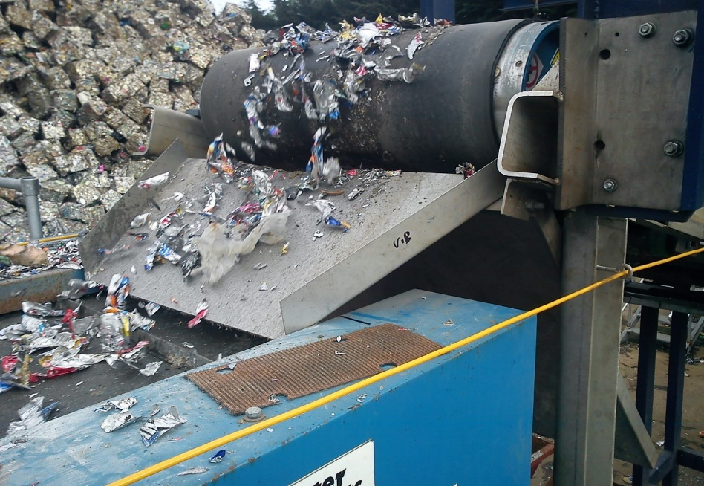
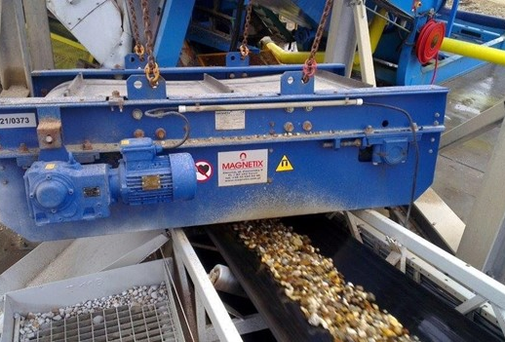
Kakamega Zero-Waste Seven WTEG Power Plants – Circular Economy
The Zero-Waste WTEG power plants will process all toxic waste, household waste, hospital waste, rubber tires, plastics, metals, furniture, paper, glass, organics, etc. All ferrous and non-ferrous metals are removed in the process and the remaining glass is crushed. The ash and crushed glass are combined with additional materials to make concrete, thereby eliminating the need for landfills.

Slide 9
Kakamega Zero-Waste Seven WTEG Power Plants – Circular Economy
The technology that we use is gasification that is used to produce heat for boilers that drive power turbines to produce electricity. Because we combine the process with co-generation (combined-cycle) our hybrid technology will produce approximately 18 MW from 500 tons of MSW per day for each Zero-Waste WTEG power plant. Approximately one megawatt of electricity is used by the plant.
9

Slide 10
Kakamega Zero-Waste Seven WTEG Power Plants – Circular Economy
9.
Kakamega will provide to Alset Power Company a 25-year concession to process 3,500 tons per day of MSW. With the understanding that the concession can be renewed for an additional ten years.
Kakamega agrees to pay a tipping fee (if it exists) of $10.00. or its equivalent Kenya Shilling rate per dollar per ton of MSW processed by Alset’s Zero Waste WTEG power plants.
The Kakamega local government is responsible for the payment of the tipping fee, if appropriate. Additionally, the Kenya Power utility company or Kakamega County will agree to sign a formal power purchase agreement (PPA) that would allow for payment of $0.11 cents or its equivalent Kenya Shillings to a dollar rate for each kilowatt hour of electricity produced by the WTEG power plants built by Siemens/Alset Power Company.
Kakamega would receive a negotiable 10% of the profits of the combined projects for the term of the concession and Alset Power Company will receive the remaining negotiable 90% of the profits of the venture.
10

Slide 11
Kakamega Zero-Waste Seven WTEG Power Plants – Circular Economy
Alset Power Company’s Zero-Waste WTE gasification technology will virtually eliminate the need of future waste landfills in Kakamega. The Zero-Waste WTEG power plants will eliminate the ultimate contamination of ground water caused by landfills. Our WTEG power plants finally eliminate the vermin, germs, diseases, deaths and odors associated with garbage landfills because each of our projects stores all of the MSW inside a building which maintains a negative air pressure.
11

Slide 12
Kakamega Zero-Waste Seven WTEG Power Plants – Circular Economy
For each 500 tons of MSW per day WTEG power plant built, Alset Power Company will create more than 100 full-time jobs for local people in Kakamega. This will certainly benefit the economy as we are expecting to create more than 200 full-time jobs per plant with the completion of these projects.
12

Slide 13
Kakamega Zero-Waste Seven WTEG Power Plants – Circular Economy
Alset Power Company will hire hundreds of people to clean up the sidewalks and streets throughout Kakamega and will pay people to bring garbage or waste to certain collection points that would be strategically located throughout Kakamega. The idea is to provide payment for people who are without jobs and provide a benefit to the country at the same time.

Slide 14
Kakamega Zero-Waste Seven WTEG Power Plants – Circular Economy
Alset Power Company will also purchase or have built 100 special gas or electric rickshaw tricycles that would be employed to collect garbage and waste from sidewalks and streets throughout Kakamega. Special collection depots would be set up in approved areas around Kakamega. All of these rickshaw vehicles will be monitored with a GPS device so as to determine the efficiency of the work to be done.

Slide 15
Kakamega Zero-Waste Seven WTEG Power Plants – Circular Economy
Alset Power Company would provide additional 50 Heil garbage trucks included in the project funding to collect the MSW and provide dumpster containers in neighborhoods in which to deposit the household waste. The numbers of which would be negotiated with Kakamega County Government.
15

Slide 16
Kakamega Zero-Waste Seven WTEG Power Plants – Circular Economy
The anticipated Waste-to-Energy (WTE) venture with Kakamega County and Alset Power Company, Inc. will comply with all national guidelines and with DENR policy objectives with regard to waste management. Alset Power Company shall insure the proper disposal of domestic, commercial and hospital wastes through the development of a waste disposal program and operation of disposal sites and transfer stations (if necessary) and related infrastructure. The Kakamega County Government is responsible for the collection and transport of garbage to each plant. Trucks and Drivers will, be included in the funding at no cost to the County Government.

Slide 17
Kakamega Zero-Waste Seven WTEG Power Plants – Circular Economy
The proposed waste management project between Kakamega and Alset Power Company will be structured as a build-own-operate (BOO) project, with the understanding that Alset Power Company will continue to operate the Zero-Waste power plants for the duration of MSW availability following the start of operation of each Zero-Waste Power Plant. Kakamega County just supply the 6 acres of land for each plant and no money required for the plants from the County Government.
17

Slide 18
Kakamega Zero-Waste Seven WTEG Power Plants – Circular Economy
Because sanitary landfill sites currently in use by Kakamega will be virtually eliminated due to the establishment of WTEG power plants in strategic locations around Kakamega, existing disposal facilities will eventually be eliminated. The government of Kakamega will work closely with Alset Power Company to locate and site 6-acre industrially zoned sites on which to build each of the WTEG power plants. All sites will be near electric distribution lines with sufficient capacity to transmit the electricity produced by each of the WTEG power plants. Additionally, each of the plants 6-acre sites will be located so as to provide convenient access for the waste collection trucks from the main streets and highways.
18

Slide 19
Kakamega Zero-Waste Seven WTEG Power Plants – Circular Economy
The project also includes the construction of a monofil for fly ash disposal for use in building block manufacture, and other ancillary facilities such as monitoring systems, administration buildings, scale houses, electric distribution lines, utility systems, among others.

Slide 20
Kakamega Zero-Waste Seven WTEG Power Plants – Circular Economy
Kakamega also commits to deliver 3,500 metric tons of MSW per day, to acquire the right-of-way (“ROW”) for access roads and other utilities such as electric distribution lines, and to acquire the project site of the facility in case expropriation is required. Costs of acquisition shall be to the account of Alset Power Company.
20

Slide 21
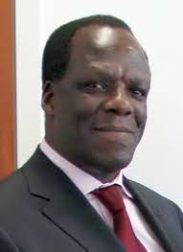
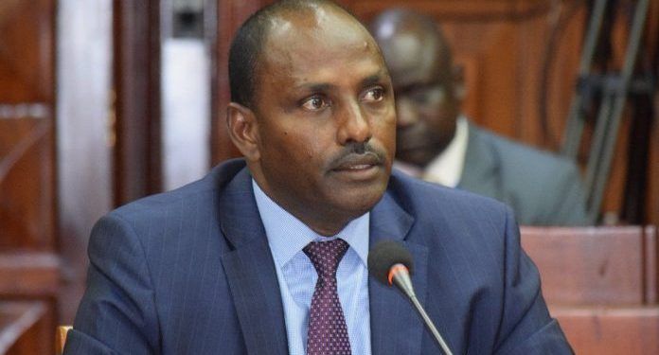
Kakamega Zero-Waste Seven WTEG Power Plants – Circular Economy
The government of Kakamega agrees to work closely with Alset Power Company in obtaining the required financing from the U.S. Exim Bank for the funding of said projects by supporting the signing off on the funding of the projects by the Minister of Finance.
Alset Power will be responsible for the loan repayment and not the Kakamega County Government.
The Minister of Finance signs off the loan and Alset Power will have another agreement signed making Alset Power the Debtor and not Kakamega County Government.
21

Slide 22
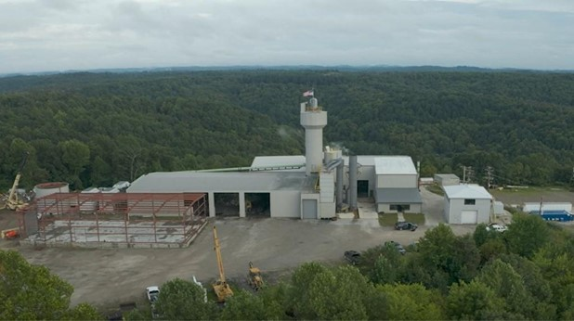
Kakamega Zero-Waste Seven WTEG Power Plants – Circular Economy
The Zero-Waste-to-Energy-Gasification power plant project (7 units) will cost approximately $525 Million Dollars to complete. The dollar rate at the date of final project approval shall prevail for its Kenya Shilling currency equivalent. This amount will not include the cost of waste collection trucks, waste collection rickshaws or any other benefits to the country unless requested.
22

Slide 23
Kakamega Zero-Waste Seven WTEG Power Plants – Circular Economy
Each of the seven (7) WTEG power plants produces 18 MW of electricity each. The total electricity production for the disposition of 3,500 tons per day of MSW for Kakamega will be approximately 126 MW. Under the terms of the agreement, Kakamega will purchase all of the electricity produced by the Alset Power Company WTEG power plants. The Technical Group of the Office of the President of Kakamega will coordinate with the offices of the Department of Energy (DOE) and Energy Regulatory Commission (ERC) for the approval of the Power Purchase Agreement (PPA). Technical Group will also coordinate with Kenya Electricity Generating Company (KENGEN) for the location of Tapping Points of the Power Lines for the WTEG Power Plants of Alset Power Company.
23

Slide 24
Kakamega Zero-Waste Seven WTEG Power Plants – Circular Economy
Alset Power Company will provide third party testing results to provide direct evidence that the technology used in the WTEG power plants to be provided will fully comply with the Kenya Clean Air Act and will be monitored 24/7 in real time with results provided to the offices of the Department of Environment and Natural Resources.
24

Slide 25
245 East 93rd Street, 9th Floor,
New York, N.Y. 10128
917-213-9622
866-624-3997
www.alsetpower.com
25

